Slide 1
PA3
Clustering
Jack, Felicia and Joost

Slide 2
Talk About the Data Itself
Numeric Features:
Administrative
Informational
Product Related
Administrative Duration
Informational Duration
Product Related Duration
Bounce Rates
Page Values
Special Day
Categorical Features:
Traffic Type
Visitor Type
Operating Systems
Browser
Region
Month
Weekend
Revenue

Slide 3
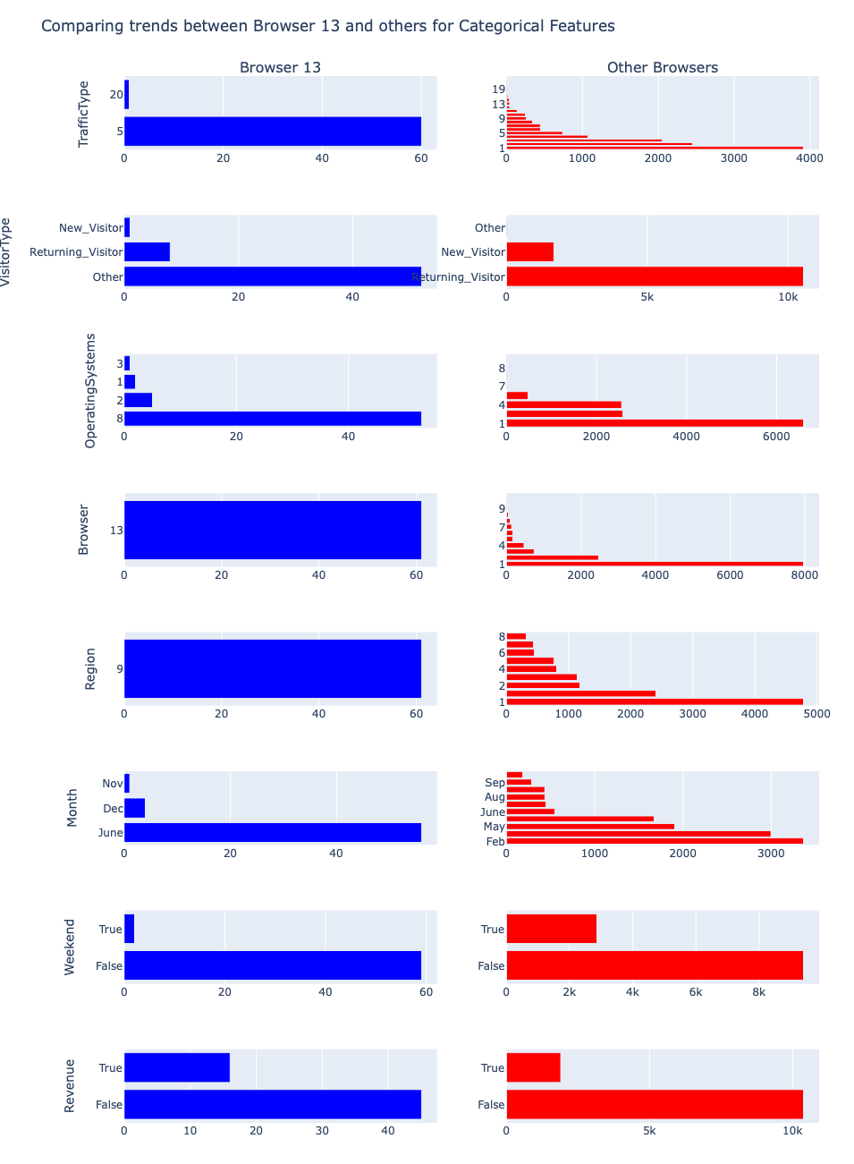
Visualization Comparing Browser 13 and Others

Slide 4
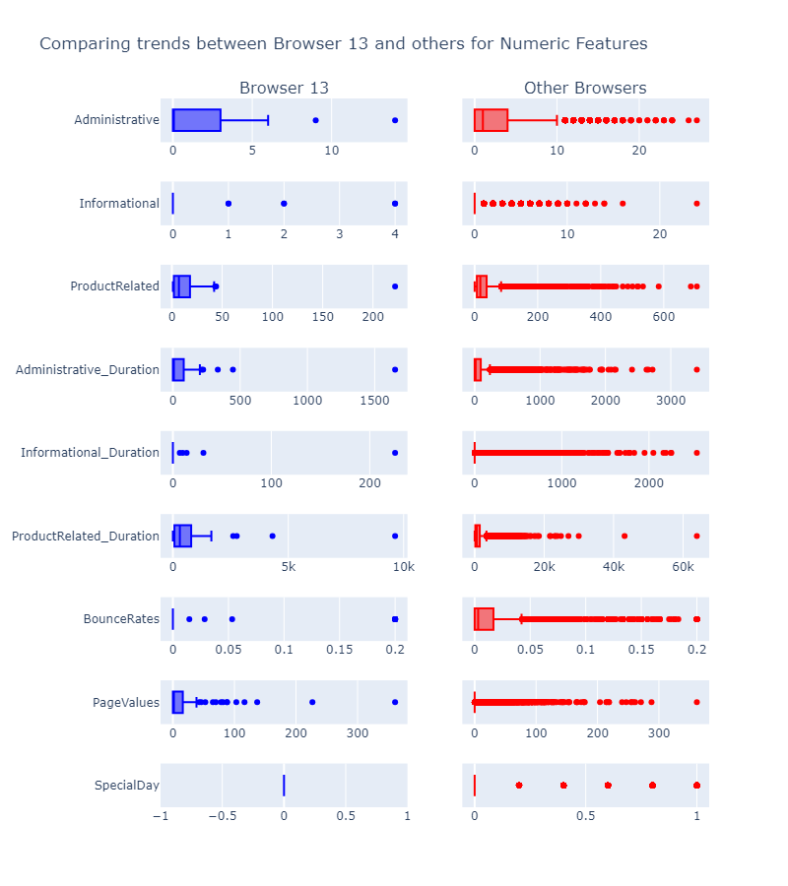
Visualization Comparing Browser 13 and Others

Slide 5
Preprocessing Method (?
Normalized

Slide 6
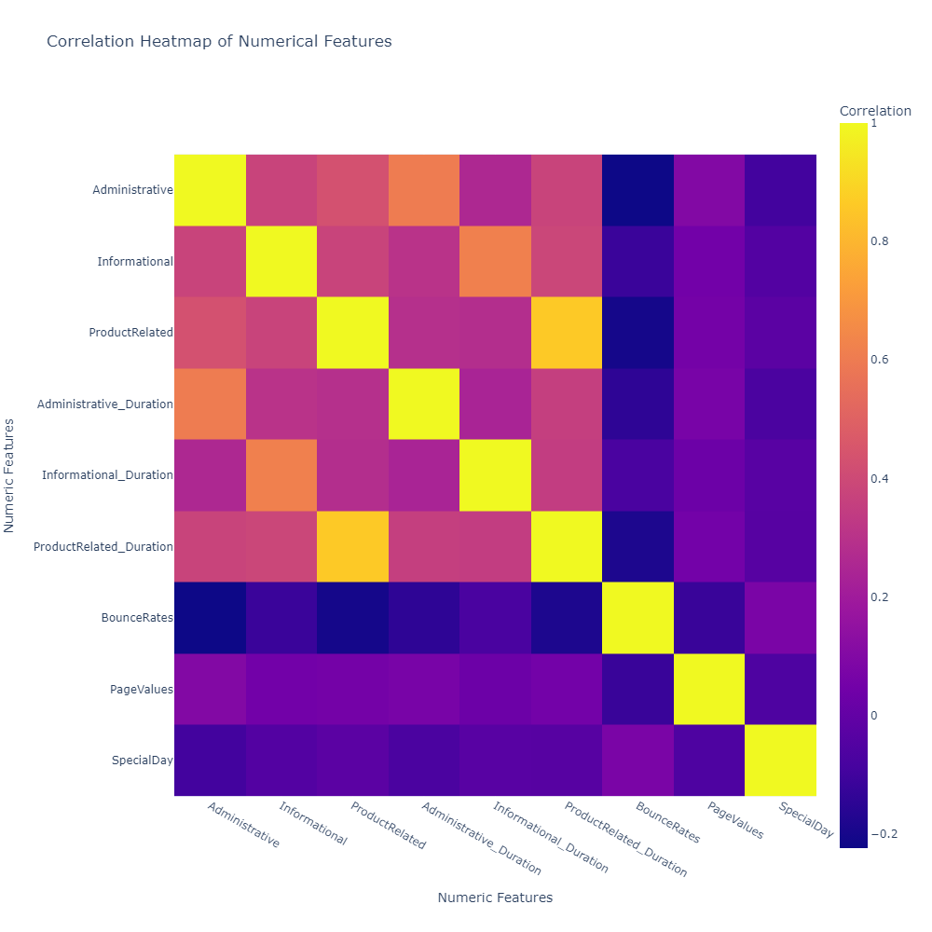
Suppose that if We're An E-commercial…
Different type of sites will have positive correlation with their duration time.
But types won’t affect any to bounce rate or page values

Slide 7
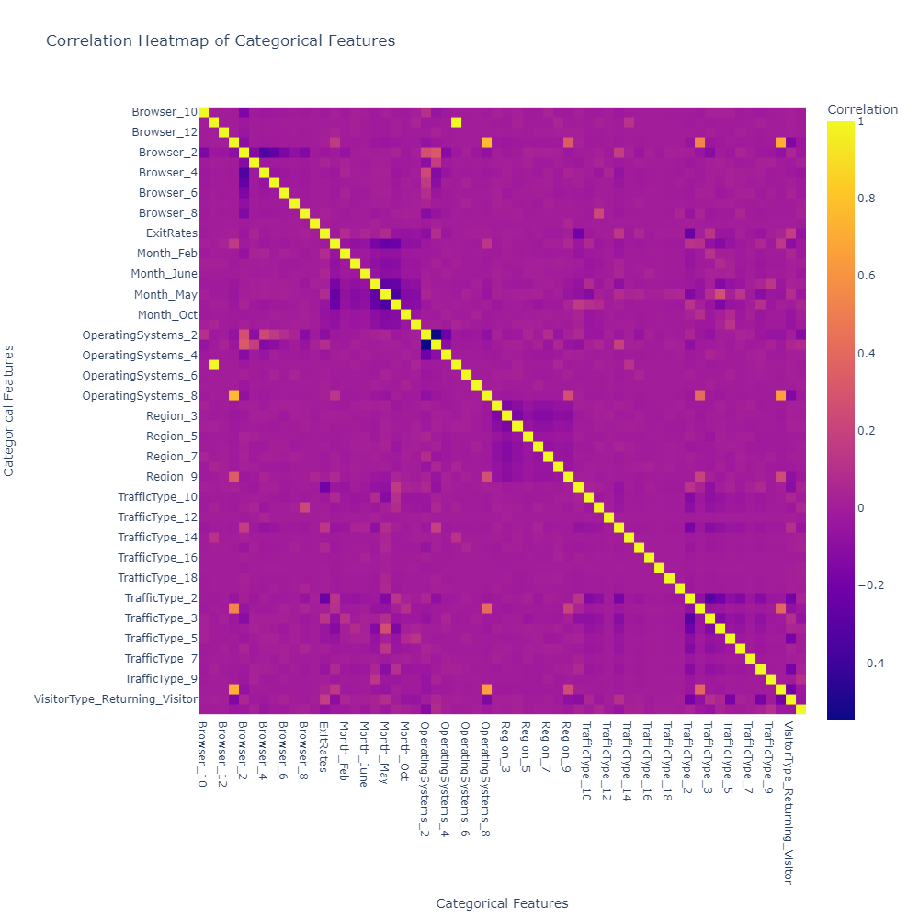
About browser 13
Operating system 8
Region 9
Traffic type 20
Visitor type other
Also
Operating system 8 has high positive correlation with traffic type 20, visitor type other

Slide 8
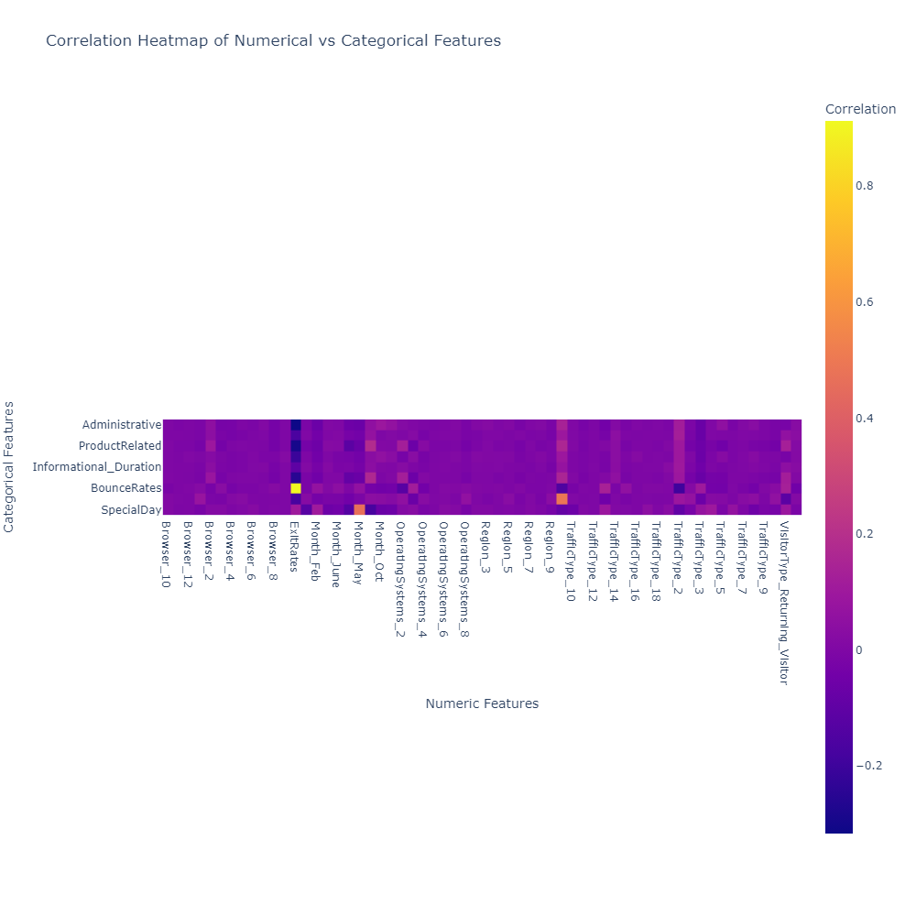

Slide 9
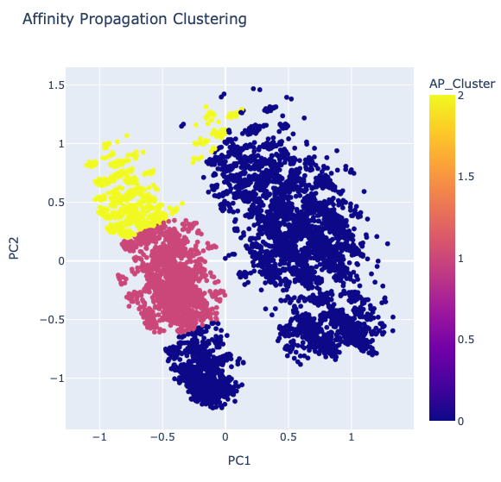
Clustering Algorithms 1 - Affinity Propagation
Model | Silhouette score | Davies-Bouldier Score | Calinsky-Harabasz Score
Affinity Propagation | 0.307416 | 0.963267 | 4668.185766

Slide 10
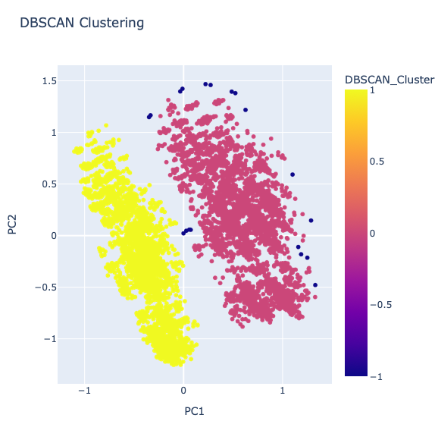
Clustering Algorithms 2 - DBSCAN Clustering
Model | Silhouette Score | Davies-Boudlin Score | Calinsky-Harabasz Score
DBSCAN | 0.401499 | 2.608033 | 5524.599755

Slide 11
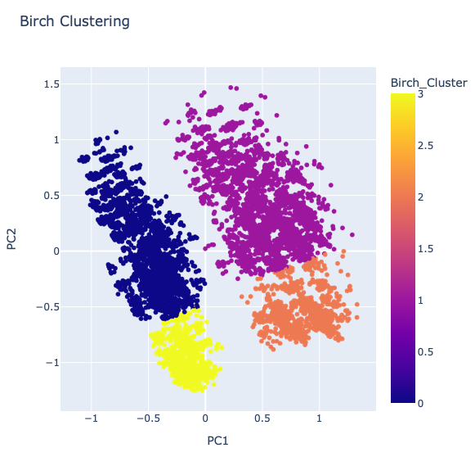
Clustering Algorithms 3 - Birch Clustering
Model Score Silhouette Score 0.474736
Davies-Bouldin Score 0.641019
Calinski-Harabasz Score 12667.449132

Slide 12
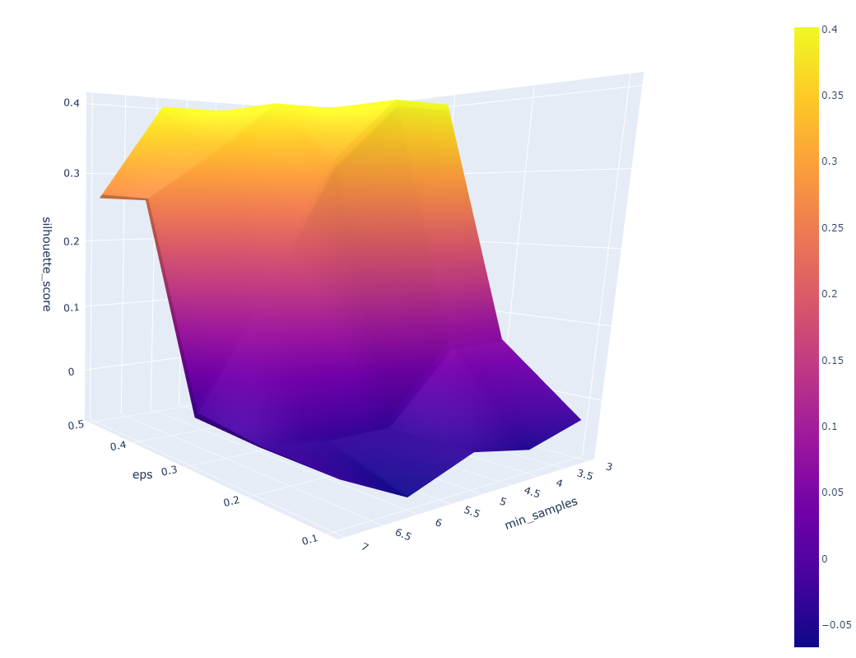
DBSCAN - Parameters Explored
Investigated the impact of eps and min_samples parameters
eps measures the distance for outlier determination
min_samples specifies the minimum neighboring points for an outlier/main point
Utilized the silhouette score for performance assessment
Lowering eps significantly enhances performance
These parameters are highly dependent on the data, but provide a rough overview of the spacing between main points and outliers

Slide 13
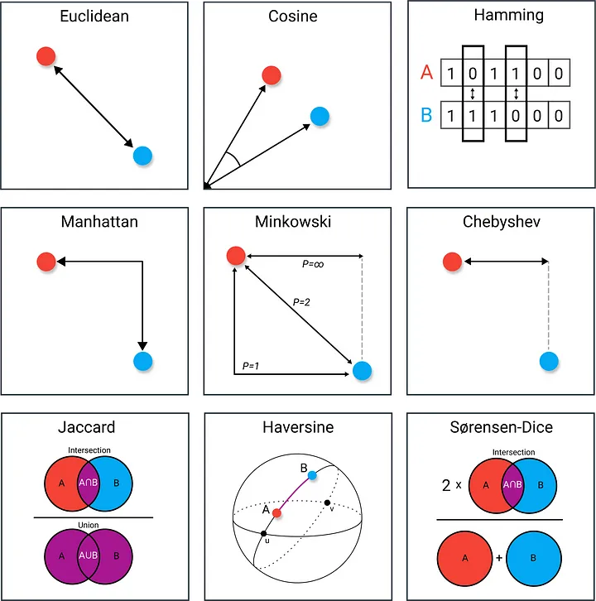
DBSCAN - Euclidean distance function
It measures the straight-line or "as-the-crow-flies" distance between two points.
It is sensitive to outliers because it squares the differences.

Slide 14

DBSCAN - Manhattan distance function
It measures the distance as if you are moving through a grid-like path (like city blocks) between two points.
It is less sensitive to outliers compared to the Euclidean distance because it uses the absolute differences.

Slide 15
DBSCAN - Cosine similarity distance function
It ranges between -1 and 1. A value of 1 indicates that the vectors are identical, 0 means they are orthogonal (unrelated), and -1 means they are diametrically opposed.
It ignores the magnitude of the vectors and focuses on their orientation in the vector space.
It is useful when you want to measure similarity in terms of the angle between vectors and not their absolute distance.

Slide 16
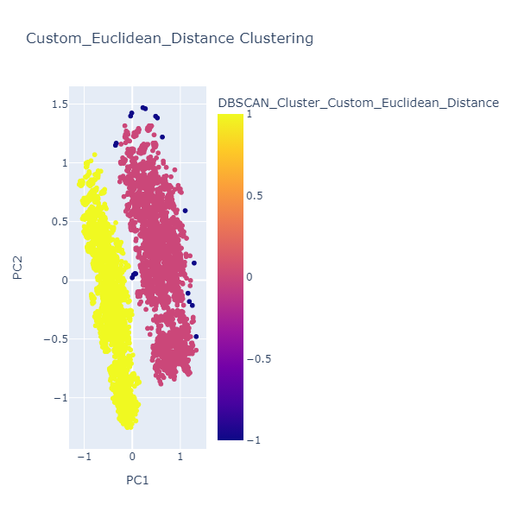
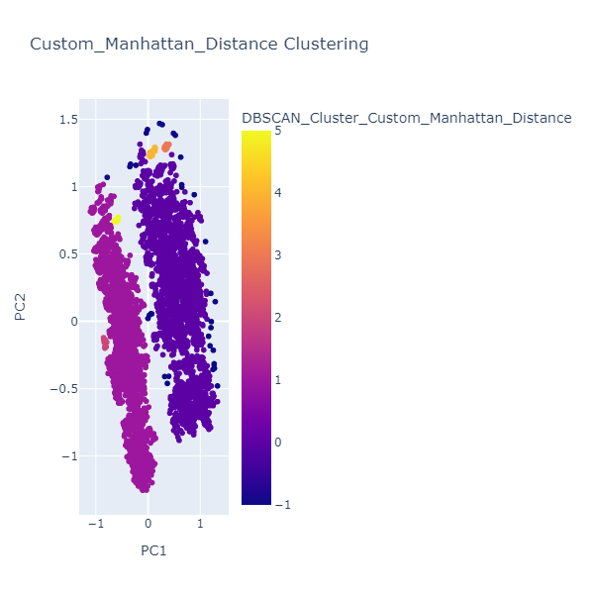
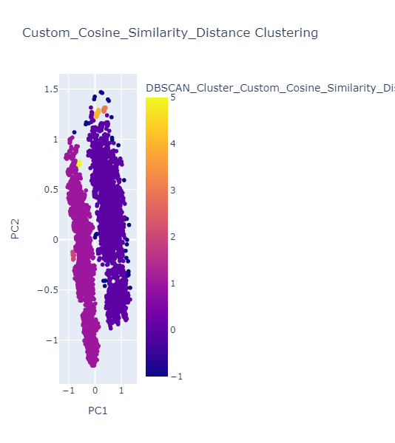
Euclidean
Manhattan
Cosine

Slide 17
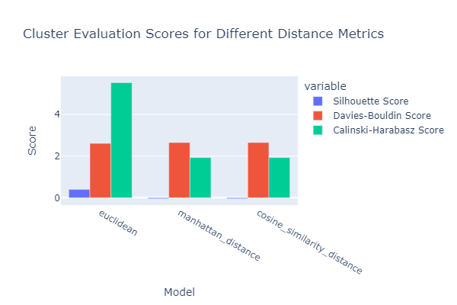
We Preferred…
Euclidean performed better using all scoring methods
Notably, all distance functions received almost the exact same DB-Score

